Slide 1
Routes into Languages Student Ambassadors:
From the Extracurricular to the Curricular
Dr. Elizabeth Andersen & Nicholas Johnston

Slide 2
Introduction
Student Ambassadors (SAs) at the heart of the Routes into Languages (RiL) project
Sustainability beyond the funded life of the project
From the Extracurricular to the curricular
Student ambassadors at the launch of Routes into Languages NE in 2007
Notes:
Background – canada paper, routes into languages legacy

Slide 3
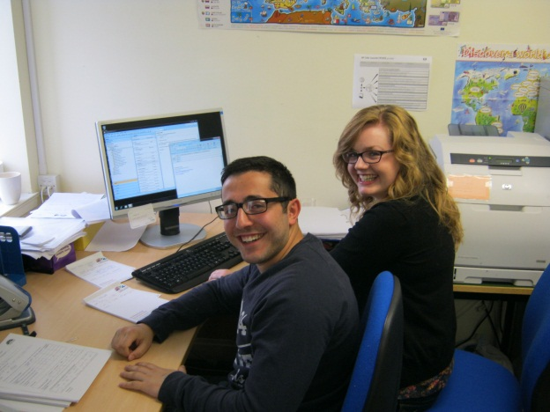
Effectiveness of the Student Ambassadors
Student Ambassadors as role models
Professionalization of the Student Ambassador role
Student ambassadors working in the Routes NE office

Slide 4
Benefits to SAs
Improved skills base
Improved student experience
Improved potential in job applications & interviews
Ambassadors at the 2012 Festival of International Culture
Notes:
(The extracurricular) - A look at the current trend towards employability and student experience within universities, a brief mention of the successes of the Routes ambassador scheme and a focus on the results of Sarah Collings investigation into student ambassadors themselves

Slide 5
Integrating into the Curriculum
Employability agenda
Embedding of the SA model within the degree curriculum
Close collaboration with School of Education and Careers Service
Ambassadors giving a Chinese taster session
Notes:
(the curricular) – discuss the existing students into schools modules available – reasons why these were previously inappropriate for MFL students and how our own module has been based on this with language elements, connections with school of education

Slide 6
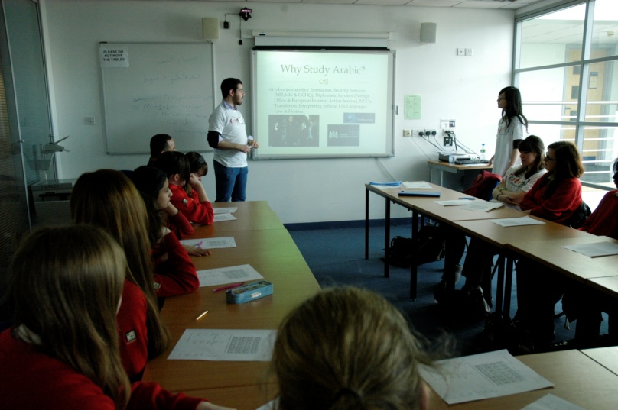
The Module
Equips students with a knowledge of Modern Language education policy and basic foreign language pedagogy
Emphasis on student self reflection and assessments in target language
SA’s role in inspiring future linguists and raising aspiration to further study
Ambassadors giving an Arabic taster session
Notes:
Further detail on the module’s aims with an emphasis on self reflection which has grown from the PDRs offered to routes into languages senior ambassadors.
Detail of the practicalities of the module – assistance from the careers service, undergraduate recruitment service and Routes into Languages existing networks.

Slide 7
The Future
Module intended both to promote the learning of languages and to provide a platform for students wishing to progress into careers in teaching
Module will continue to provide role models for pupils beyond the lifespan of RiL project
Expansion in future years, offering more students and schools the opportunity to participate
Notes:
Hopes for the future – expansion of the module, embedding in both the universities and the schools, provision of more MFL teachers

